Slide 1

Database Design 2
Hunter Bartlett
ISIN 325
Dr. Gogolin

Slide 2
Table of Contents
Assignment Details
Database Design
Database Standards

Slide 3

Assignment Details
In this assignment we were tasked to create a database with different tables including animal, class, location, habitat, diet, and an animal diet bridge table to connect the animals to their diets.

Slide 4
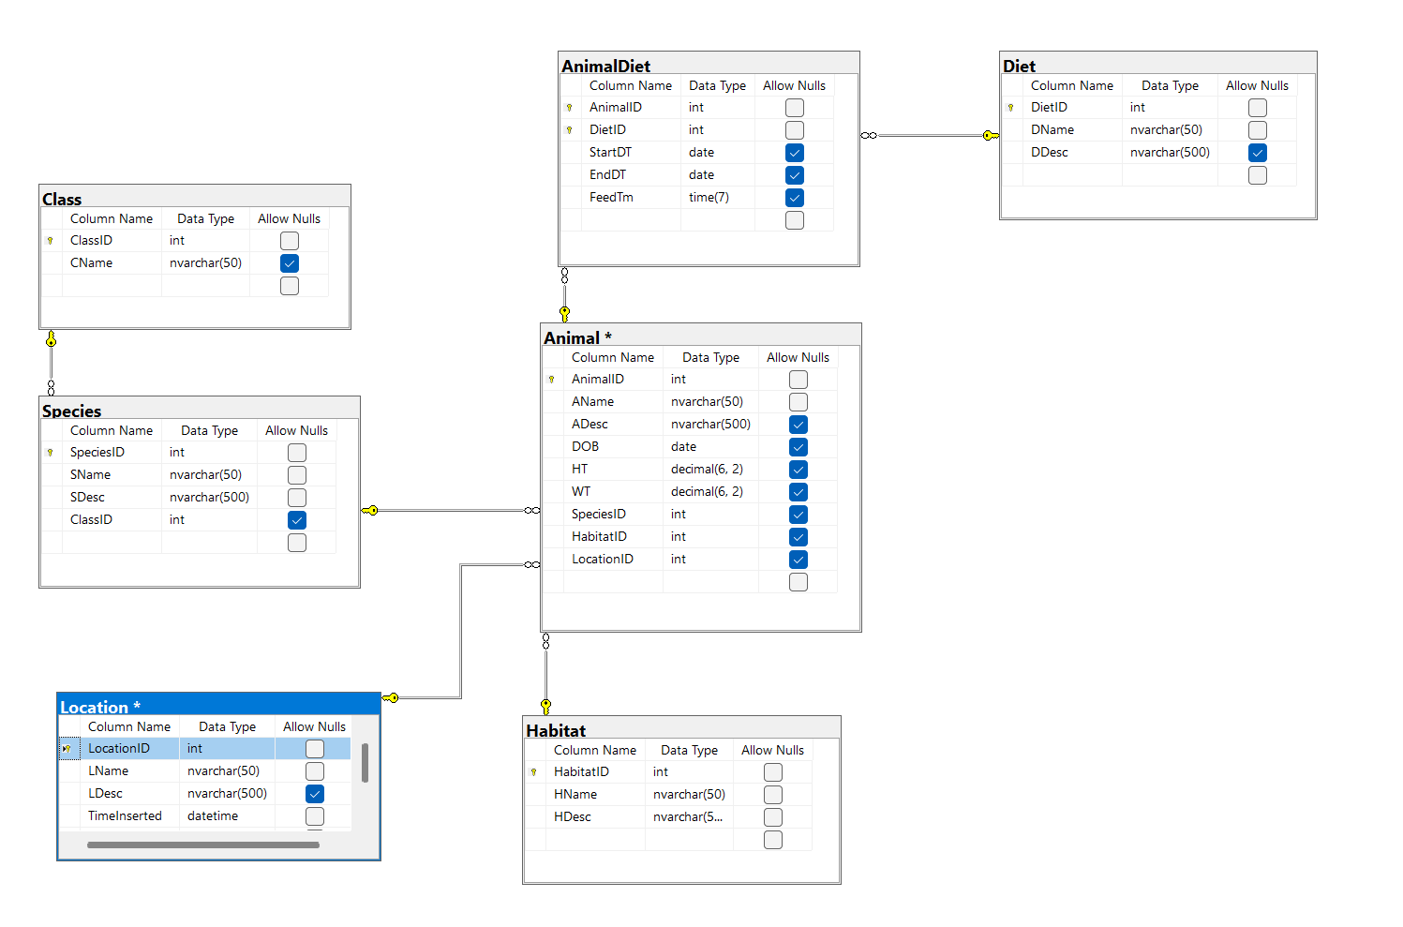
Database Design

Slide 5
Database Standards
Database uses standard naming conventions with use of Camel Case.
Tables use standard naming conventions with ID, name, and description. For example, HabitatID, HName, HDesc.
Database uses SSMS for entire database.

